Slide 1
DIGITAL ELECTRONICS
ET 8301
Friday, January 5, 2024
Mr. Cuthbert J. Karawa
Lecture 07
Functions of Combinational Logic
College of Information and Communication Technology (CoICT) Department Of Electronics And Telecommunications Engineering.

Slide 2
Introduction
The tradition way of combinational circuit design involves simplification and realization of circuit using logic gates.
This method is effective for small circuit.
When the circuit is more complex, more number of gates are required with more number of wires between them.
Designing such circuits is time consuming and less reliable.

Slide 3
Introduction
To avoid these problems several combination circuits available in integrated circuits are employed in the designing of digital systems.
Number of gates per package | Classification | Abbreviation
<10 | Small Scale Integration | SSI
10-99 | Medium Scale Integration | MSI
1000 | Large Scale Integration | LSI
10K | Very Large Scale Integration | VLSI

Slide 4
Introduction
Most combinational circuits which available in IC are classified as MSI components
MSI components which available in IC includes adders, subtractors, multiplexers, demultiplexers, decoders, encoders and comparators.
These MSI are used to implement combinational circuits.

Slide 5
Binary adder
Adder are important in computer and also in other types of digital system in which numerical data are processed.
The basic operations are the arithmetic operations which includes additions of binary digits.

Slide 6
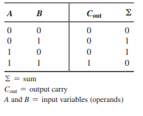
Binary adder
Half adder
Basic rules of binary addition are performed by a half adder, which has two binary inputs (A and B) and two binary outputs (Carry out and Sum).
The inputs and outputs can be summarized on a truth table.

Slide 7
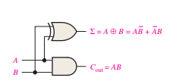

Binary adder
Half Adder
From truth table we get
The logic symbol and equivalent circuit are:

Slide 8
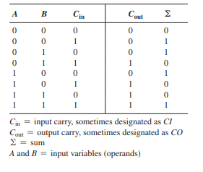

Binary adder
Full Adder
The full adder accepts two inputs bits and input carry and generates a sum output and an output carry.
The truth table summarizes the operation.

Slide 9
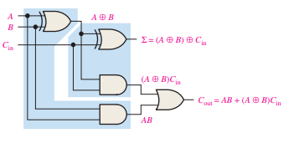
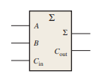
Binary adder
From the truth table we get
The logic symbol and equivalent circuit are:

Slide 10
Exercise
Implement full adder by using two half adders.

Slide 11
Binary adder
Parallel Adder
More often there a need to add two n bits numbers.
When adding two n bit number the two LSB are added to produce their sum and carry out bit.
Then the next two bits are added together with a carry generated from the addition of the first two bits to produce the sum and carry out bits
The process is repeated until the most significant bits are reached.

Slide 12
Binary adder
Parallel Adder
To add two binary numbers a full adder is required for each bit in the numbers.
Therefore for 2-bit numbers two adders are needed for 3-bit numbers three adders are needed and so on
The carry output of each adder is connected to the carry input of the next higher order adder.
Two or more full-adders are connected to form parallel binary adders.

Slide 13
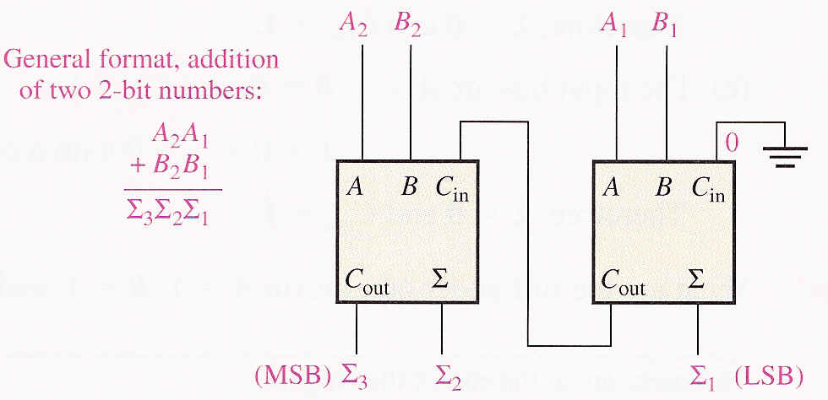
Binary adder
Parallel Adder
Figure below shows a basic 2-bit parallel adder which is implemented with two full adder stages.

Slide 14
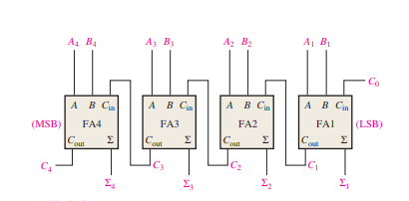
Binary adder
Parallel Adders
A 4-bit adder is shown figure below.
The output carry (C₄) is not ready until it propagates through all of the full adders. This is called ripple carry, delaying the addition process.

Slide 15
Exercise
Determine the sum generated by the 3-bit parallel adder and show the intermediate carries when the binary number 101 and 011 are being added

Slide 16
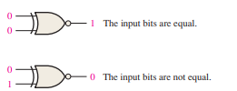

Comparators
The basic function of a comparator is to compare the magnitudes of two binary quantities to determine the relationship of those quantities.
The exclusive-NOR gate can be used as a basic comparator because its output is a 0 if the two input bits are not equal and a 1 if the input bits are equal.
Figure above shows the exclusive-NOR gate as a 2-bit comparator.

Slide 17
Decoders
A decoder is a digital circuit that detects the presence of a specified combination of bits (code) on its inputs and indicates the presence of that code by a specified output level.
In general a decoder has multiple inputs and multiple outputs.
The are several types of decoder but the most common is n to 2^{n} type of decoder e.g. 2 to 4,3 to 8 and 4 to 16 line decoders.

Slide 18
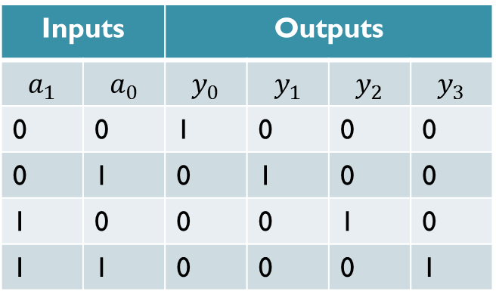
Decoders
Example:
Show truth table and block diagram of 2 to 4 line decoder
Truth table
Block diagram
Inputs |  | Outputs
0 | 0 | 1 | 0 | 0 | 0
0 | 1 | 0 | 1 | 0 | 0
1 | 0 | 0 | 0 | 1 | 0
1 | 1 | 0 | 0 | 0 | 1

Slide 19
Decoders
From truth table it can be observed that the output variables are mutually exclusive because only one output can be equal to 1 at any one time.
The output line whose value is equal to 1 represents the minterm equivalent of the binary number presently available in the input lines.

Slide 20
Decoders
From truth table we can write
Figure: Implementation of 2 to 4 line decoder

Slide 21
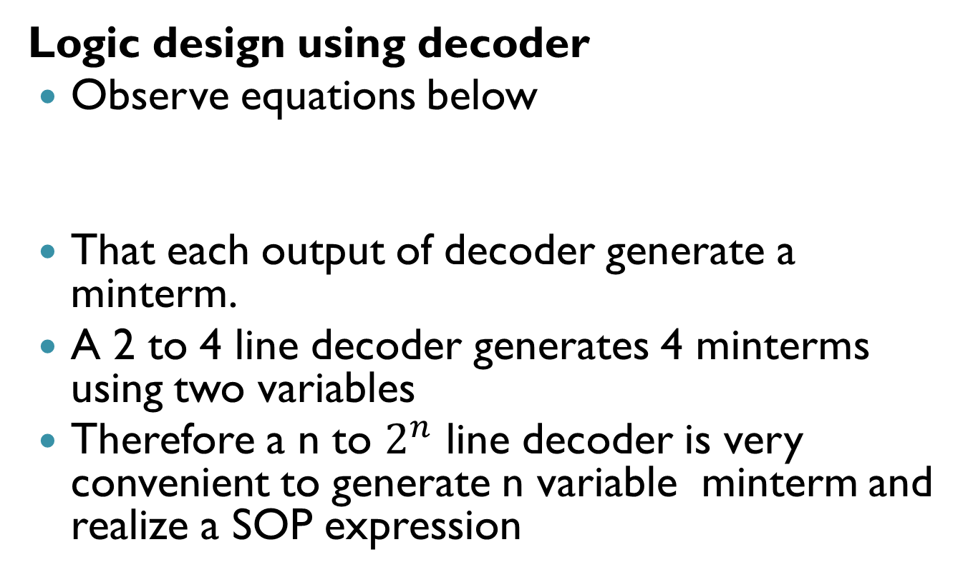
Decoders
.

Slide 22
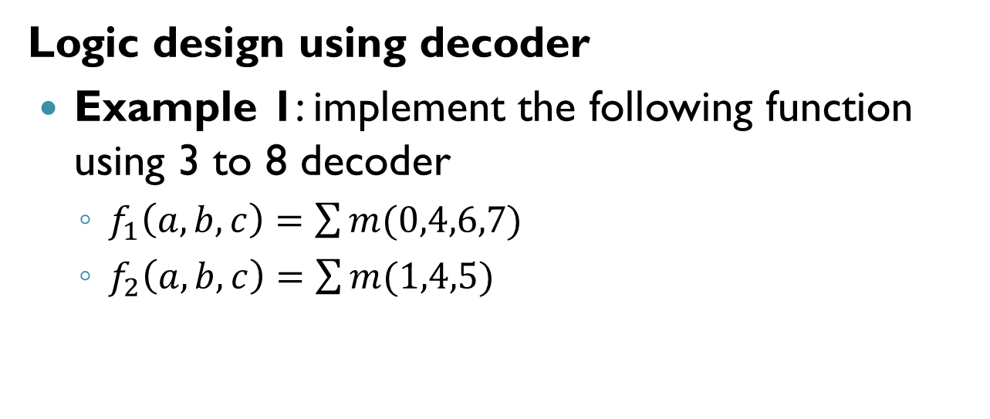
Decoders

Slide 23
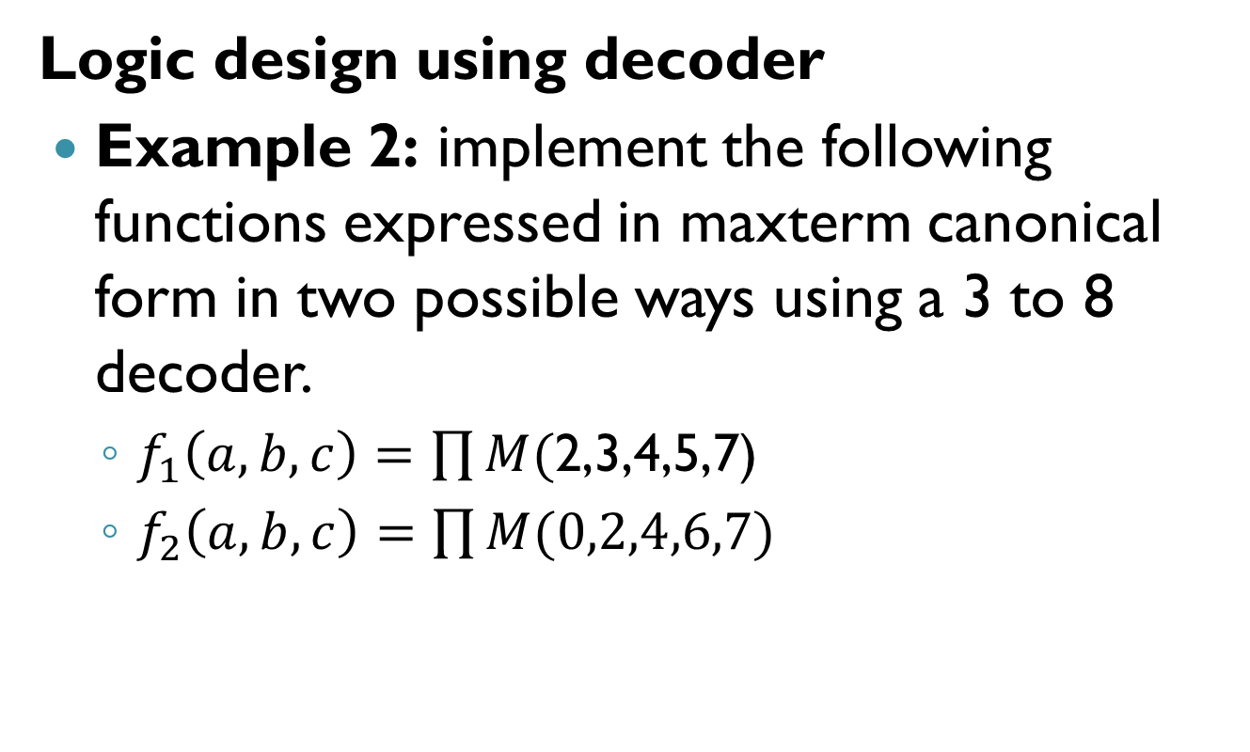
Decoders
.

Slide 24
Decoders
Logic design using decoder
The number of inputs to each or gate can be minimized by implement the f’ instead of f and finally invert the OR output to get f.
Example:
Implement the following functions using a decoder minimizing the number of inputs to be summed.

Slide 25
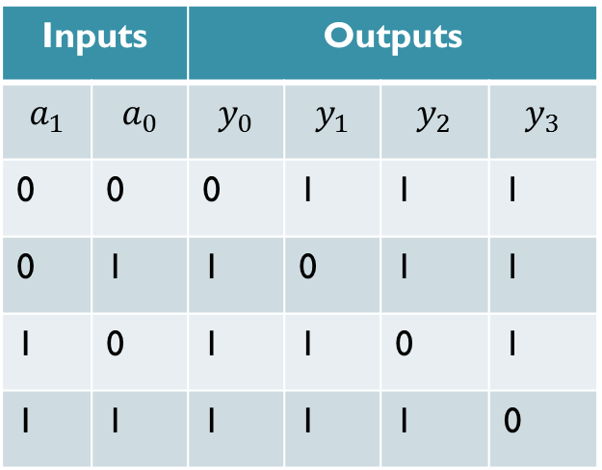
Decoders
Logic design using decoder
The decoder in IC packages usually have an active low output. The truth table and symbol of such 2 to 4 line decoder.
These generate maxterms at their output and are useful in implementing canonical POS expression.
Inputs |  | Outputs
0 | 0 | 0 | 1 | 1 | 1
0 | 1 | 1 | 0 | 1 | 1
1 | 0 | 1 | 1 | 0 | 1
1 | 1 | 1 | 1 | 1 | 0

Slide 26
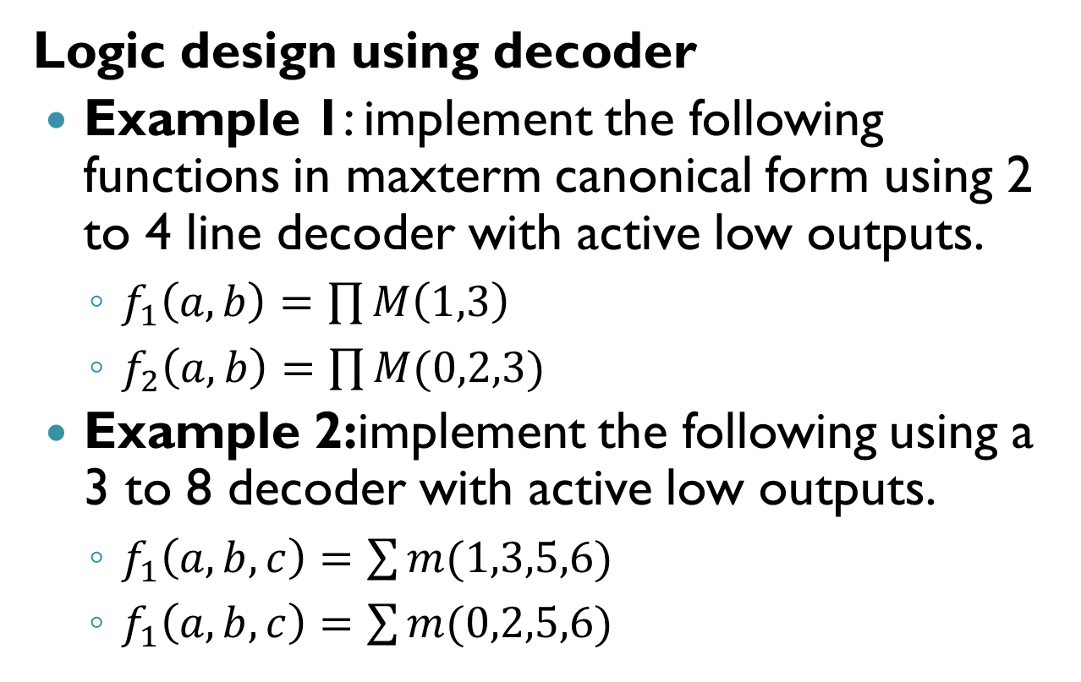
Decoders

Slide 27
Decoders
Logic design using decoder
Functions expressed in maxterm canonical forms can also be implemented using decoder.
Example: implement the following functions expressed in maxterm canonical form in two possible ways using a 3 to 8 decoder.

Slide 28
Decoders
Decoders with Enable Input
On previous decoder one of the input is either 1 or 0 for active high and low outputs respectively.
Enable input is used for some application where more than one output need to be at 0 or 1 state.
Enable inputs are also useful in cascading decoders to increase their input and outputs lines.

Slide 29
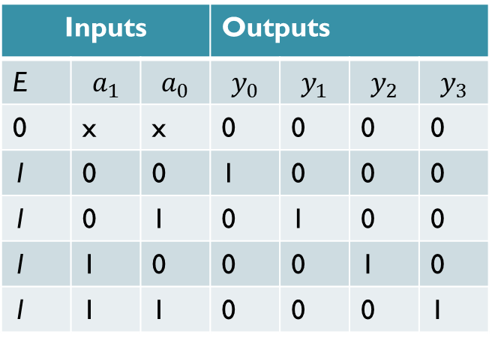
Decoders
Decoders with Enable Input
The truth table and symbol of 2 to 4 line decoder with enable for uncomplemented (active high) output is as shown
Inputs |  |  | Outputs
E
0 | x | x | 0 | 0 | 0 | 0
1 | 0 | 0 | 1 | 0 | 0 | 0
1 | 0 | 1 | 0 | 1 | 0 | 0
1 | 1 | 0 | 0 | 0 | 1 | 0
1 | 1 | 1 | 0 | 0 | 0 | 1

Slide 30
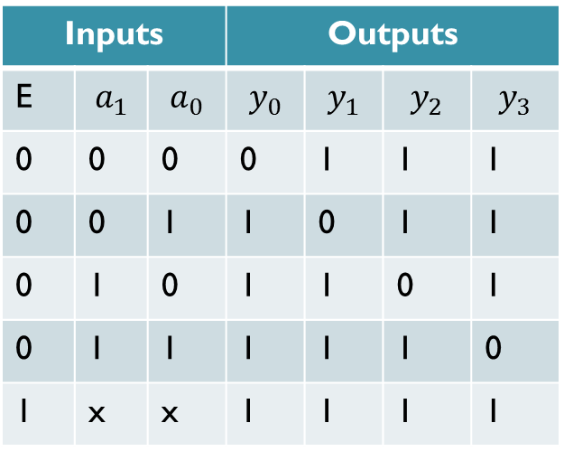
Decoders
Decoders with Enable Input
The enable input can also be included in decoder with complemented (active low) output as shown
Inputs |  |  | Outputs
E
0 | 0 | 0 | 0 | 1 | 1 | 1
0 | 0 | 1 | 1 | 0 | 1 | 1
0 | 1 | 0 | 1 | 1 | 0 | 1
0 | 1 | 1 | 1 | 1 | 1 | 0
1 | x | x | 1 | 1 | 1 | 1

Slide 31
Encoders
An encoder has 2^{n} inputs and n outputs.
Outputs the binary value of the selected (or active) input.
Performs the inverse operation of a decoder.
Some examples of encoders are 4to 2 line and 8 to 3 line encoders
Notes:
]\

Slide 32
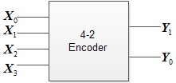
Encoders
Truth Table of 4-2line encoder
Block diagram of 4-2line encoder
X₀ | X₁ | X₂ | X₃ | Y₁ | Y₀
1 | 0 | 0 | 0 | 0 | 0
0 | 1 | 0 | 0 | 0 | 1
0 | 0 | 1 | 0 | 1 | 0
0 | 0 | 0 | 1 | 1 | 1
Notes:
]\

Slide 33
Priority Encoders
If more than one input is active the higher order input has priority over the lower order input
The higher value is encoded at the output
A valid indicator is included to indicate whether or not the output is valid
Output is invalid (0) when no inputs are active.
Output is valid (1) when at least one input is active

Slide 34
Priority Encoders
The truth table of 4-2 line priority encoder
X₀ | X₁ | X₂ | X₃ | Y₁ | Y₀ | Valid
0 | 0 | 0 | 0 | 0 | 0 | 0
1 | 0 | 0 | 0 | 0 | 0 | 1
x | 1 | 0 | 0 | 0 | 1 | 1
x | x | 1 | 0 | 1 | 0 | 1
x | x | x | 1 | 1 | 1 | 1

Slide 35

Multiplexer
A multiplexer (MUX) selects one data line from two or more input lines and routes data from the selected line to the output
Multiplexer has a set of n address lines(select inputs) to select one of these $2^{n}$ inputs.
Multiplexer also has one or more enable inputs.

Slide 36
Multiplexer
Symbol of 4-1 MUX

Slide 37
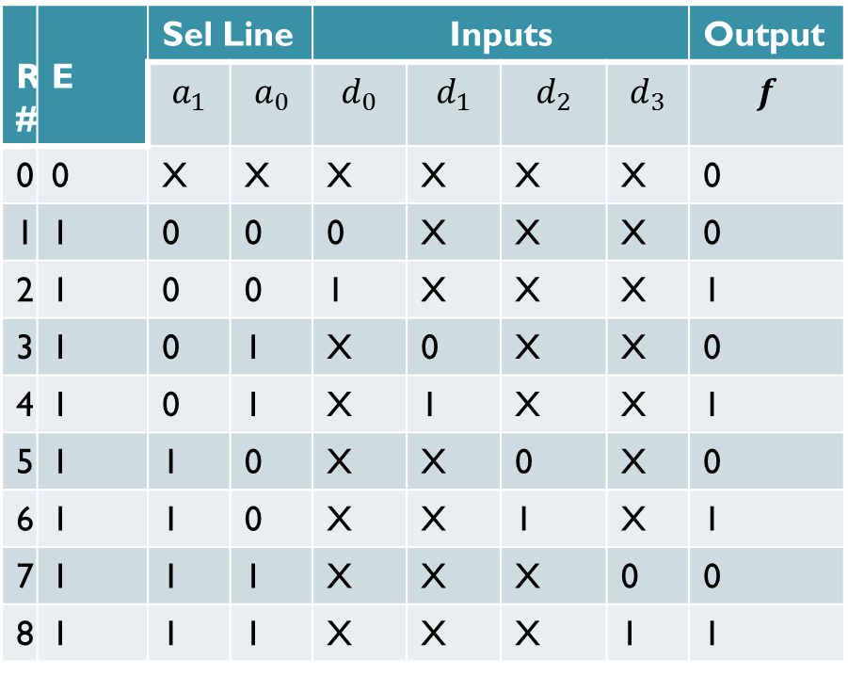
Multiplexer
Truth table of 4 to 1 MUX
Row no. | E | Sel Line |  | Inputs |  |  |  | Output
0 | 0 | X | X | X | X | X | X | 0
1 | 1 | 0 | 0 | 0 | X | X | X | 0
2 | 1 | 0 | 0 | 1 | X | X | X | 1
3 | 1 | 0 | 1 | X | 0 | X | X | 0
4 | 1 | 0 | 1 | X | 1 | X | X | 1
5 | 1 | 1 | 0 | X | X | 0 | X | 0
6 | 1 | 1 | 0 | X | X | 1 | X | 1
7 | 1 | 1 | 1 | X | X | X | 0 | 0
8 | 1 | 1 | 1 | X | X | X | 1 | 1

Slide 38
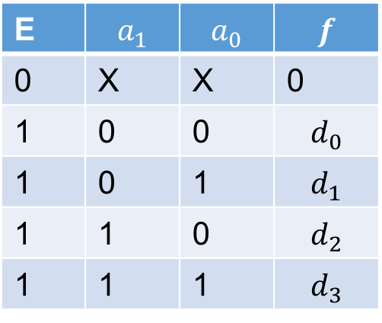

Multiplexer
From truth table functional description can be represented in a functional table.
The output can be expressed as follows
$$f=\left(d_{0}\overline{a_{1}} \overline{a_{0}}+d_{1}\overline{a_{1}}a_{0}+d_{2}a_{1}\overline{a_{0}}+d_{3}a_{1}a_{0}\right)E$$
E | $$a_{1}$$ | $$a_{0}$$ | $$f$$
0 | X | X | 0
1 | 0 | 0 | $$d_{0}$$
1 | 0 | 1 | $$d_{1}$$
1 | 1 | 0 | $$d_{2}$$
1 | 1 | 1 | $$d_{3}$$

Slide 39
Multiplexer
The 4 to one multiplexer can be implemented as shown in figure
Several multiplexer are available in IC packages.

Slide 40
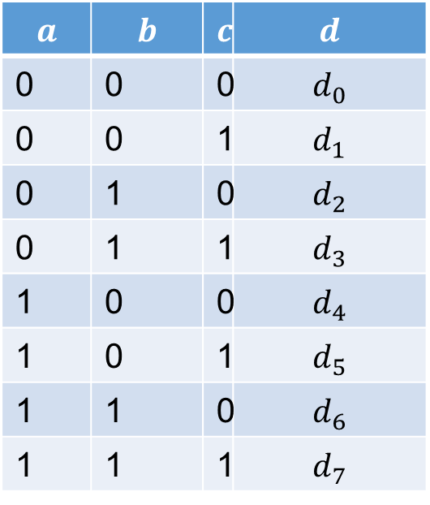
Multiplexer
Logic Design using Multiplexers
MUX is ideal to implement functions expressed as a sum of their minterms.
Let us look on 8 to 1 MUX
$$a$$ | $$b$$ | $$c$$ | $$d$$
0 | 0 | 0 | $$d_{0}$$
0 | 0 | 1 | $$d_{1}$$
0 | 1 | 0 | $$d_{2}$$
0 | 1 | 1 | $$d_{3}$$
1 | 0 | 0 | $$d_{4}$$
1 | 0 | 1 | $$d_{5}$$
1 | 1 | 0 | $$d_{6}$$
1 | 1 | 1 | $$d_{7}$$

Slide 41

Multiplexer
Logic Design using Multiplexers
Let enable E=1. equation for a 8 to 1 MUX with reference to figure can be written as
$$f\left(a,b,c\right)=d_{0}\overline{a}\overline{b}\overline{c}+d_{1}\overline{a}\overline{b}c+d_{2}\overline{a}b\overline{c}+d_{3}\overline{a}bc+d_{4}a\overline{b}\overline{c}+d_{5}a\overline{b}c+d_{6}ab\overline{c}+d_{7}abc$$
$$f\left(a,b,c\right)=d_{0}m_{0}+d_{1}m_{1}+d_{2}m_{2}+d_{3}m_{3}+d_{4}m_{4}+d_{5}m_{5}+d_{6}m_{6}+d_{7}m_{7}$$

Slide 42

Multiplexer
Logic Design using Multiplexers
To implement a three variable function expressed in terms of its minterms, simply needed to set the data input lines as $d_{i}=1$ for $f=1$and $d_{i}=0$ for $f=0$

Slide 43
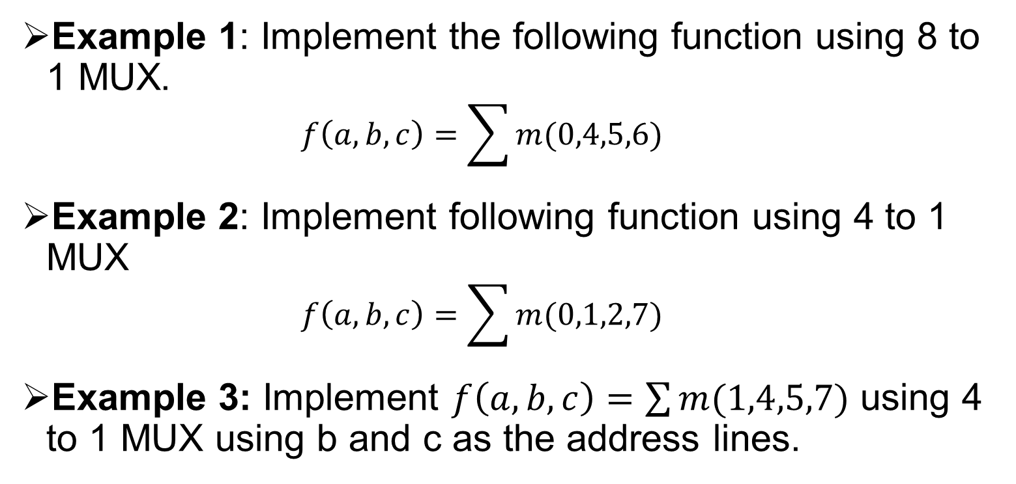
Multiplexer
Example 1: Implement the following function using 8 to 1 MUX.
$$f\left(a,b,c\right)=\sum{m(0,4,5,6)}$$
Example 2: Implement following function using 4 to 1 MUX
$$f\left(a,b,c\right)=\sum{m(0,1,2,7)}$$
Example 3: Implement $f\left(a,b,c\right)=\sum{m(1,4,5,7)}$ using 4 to 1 MUX using b and c as the address lines.

Slide 44
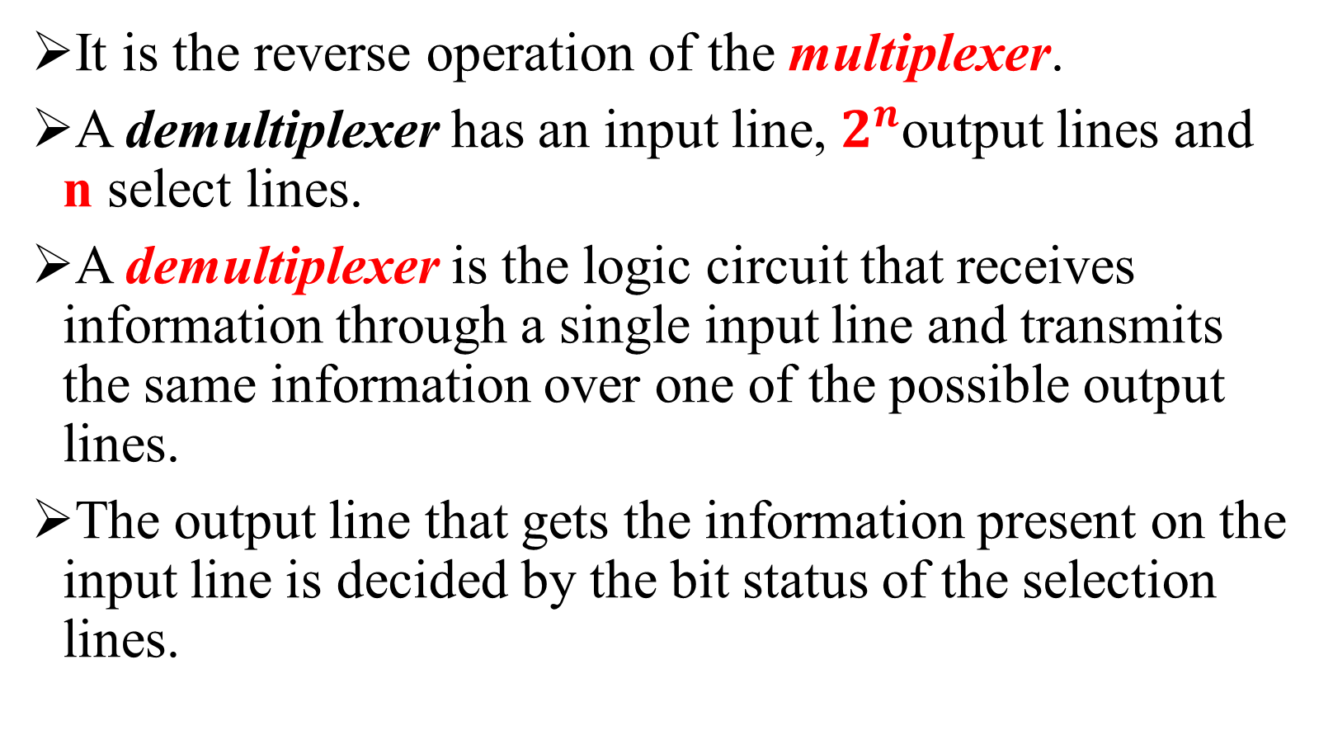
Demultiplexer
It is the reverse operation of the multiplexer.
A demultiplexer has an input line, $2^{n}$output lines and n select lines.
A demultiplexer is the logic circuit that receives information through a single input line and transmits the same information over one of the possible output lines.
The output line that gets the information present on the input line is decided by the bit status of the selection lines.

Slide 45
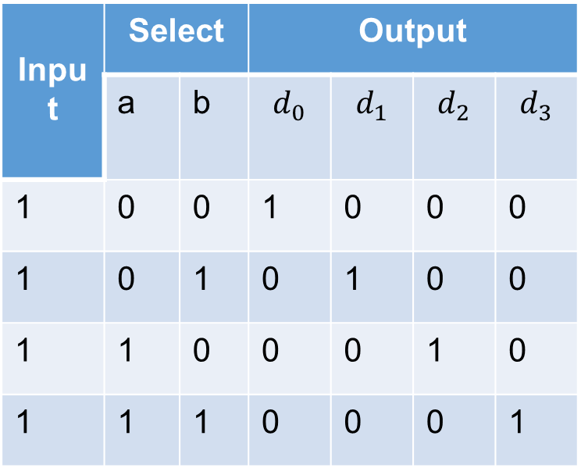
Demultiplexer
Example of 1 to 4 DEMUX
Input | Select |  | Output
 | a | b | $$d_{0}$$ | $$d_{1}$$ | $$d_{2}$$ | $$d_{3}$$
1 | 0 | 0 | 1 | 0 | 0 | 0
1 | 0 | 1 | 0 | 1 | 0 | 0
1 | 1 | 0 | 0 | 0 | 1 | 0
1 | 1 | 1 | 0 | 0 | 0 | 1

Slide 46
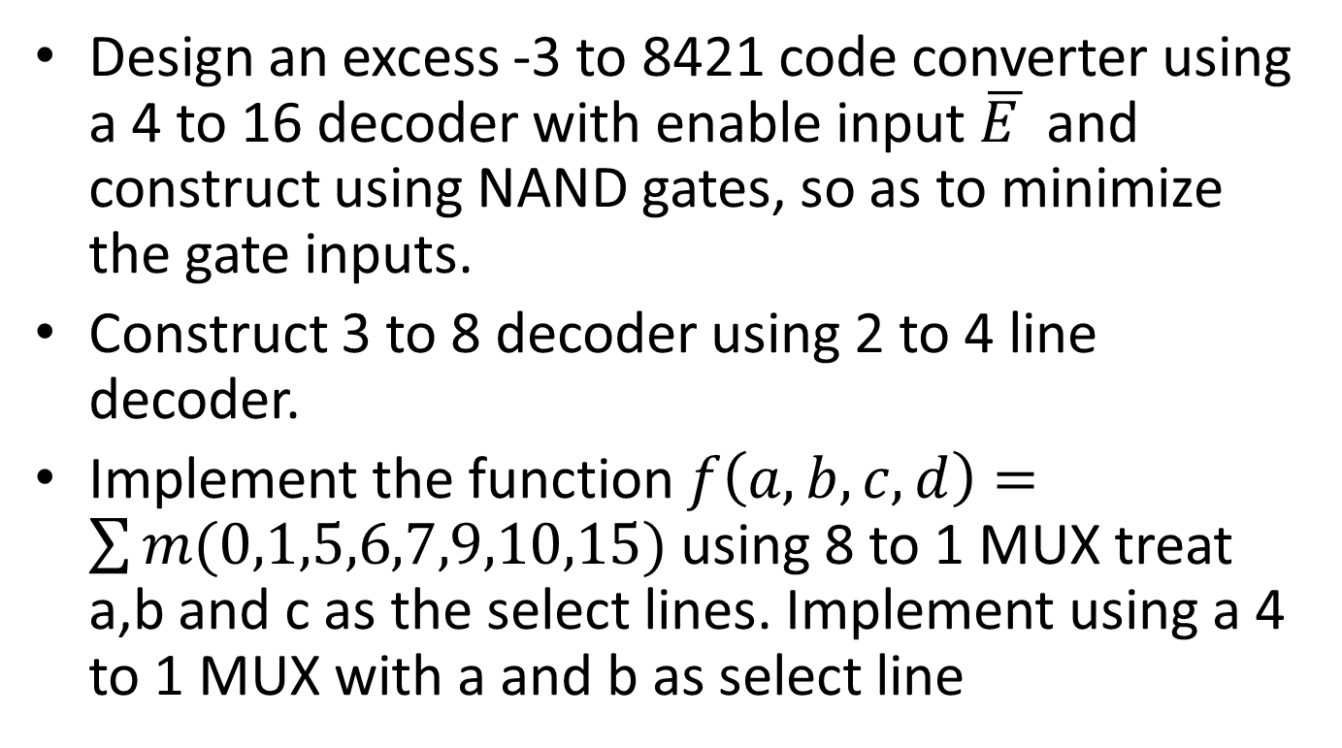
Tutorials

Slide 47
Tutorials
Implement a full adder circuit with a decoder and two OR gates.

Slide 48
Homework
Study on
Look ahead Carry adder

Slide 49

49
Notes:
49

Slide 50
Next Lecture
50
Notes:
50

